Slide 1
Dynamic Binary Translation of VLIW Codes on Scalar Architectures
Luc Michel and Frédéric Pétrot, Member, IEEE
IEEE TRANSACTIONS ON COMPUTER-AIDED DESIGN OF INTEGRATED CIRCUITS AND SYSTEMS, VOL. 36, NO. 5, MAY 2017

Slide 2
Outline
Introduction
VLIW architecture simulation with DBT
Experimentation
Conclusion

Slide 3
Outline
Introduction
VLIW architecture simulation with DBT
Experimentation
Conclusion

Slide 4
Motivation
no solution for the dynamic translation of VLIW codes on scalar architectures has been detailed in the literature.

Slide 5
Contributions
The definition of an instruction interpretation algorithm for VLIW processors on a scalar processor that deals with the general problem of dynamically translating code
A refined version of the algorithm suited for use in a dynamic binary translator and its actual implementation.

Slide 6
Translation
source : c6x (VLIW)
target : QEMU IR

Slide 7
Outline
Introduction
VLIW architecture simulation with DBT
Experimentation
Conclusion

Slide 8
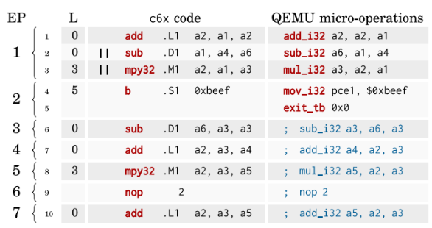
Problems
There is three problems when classical DBT algorithm applied to a VLIW
There is no hazard in execute packet(EP), but DBT will produce additional hazard.
Each instruction in VLIW has its latency, but DBT ignores it.
The branch instruction has delay slot, but DBT ignores it.

Slide 9
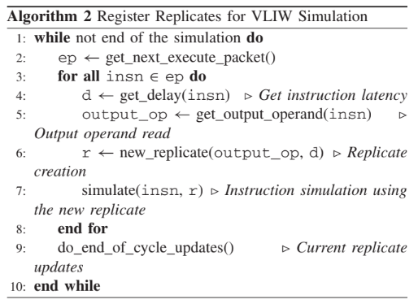
Algorithm for VLIW Architecture Simulation
The main idea is to use multiple memory locations for the same target register.
The multiple memory locations is called replicate.
The simulator knows which replicate it must use to read the current value of a register, called current replicate.

Slide 10
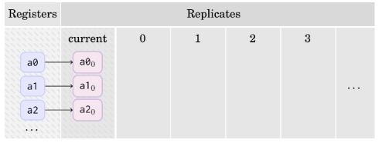
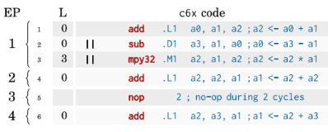
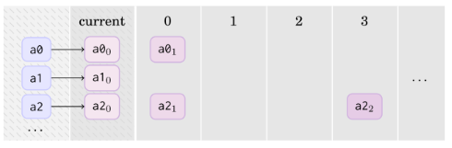
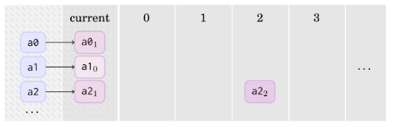
Example
initial state
simulate EP 1

Slide 11
Efficient Replicates Allocation
New replicates are created each time a register is written. -> not efficient
Replicates have a short lifespan that cannot exceed the longest latency p among all instructions.
At worst, there are p + 1 replicates alive for the same register r at the same time.
Create a buffer for replicates, and this buffer size is n × (p + 1) with n the number of target registers.

Slide 12
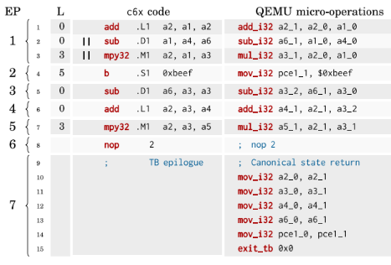
Problems Induced by TB
The register → replicate matching is unknown
solution : canonical state between TBs
At the end of each TB, the translator generates copies for all registers that do not use replicate 0 from the current replicate to replicate 0.

Slide 13
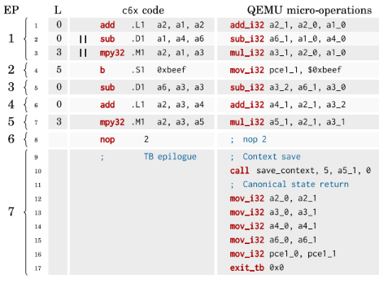
Problem of canonical state
A problem arise when there are still replicates in the waiting queue at the end of the TB.
Solution : dynamic waiting queue
At the end of each TB, check whether replicates stay at waiting queue.
If yes, call a function save_context to store the register ID that must be modified, the value to apply to it, and the number of cycles before the modification happens.

Slide 14
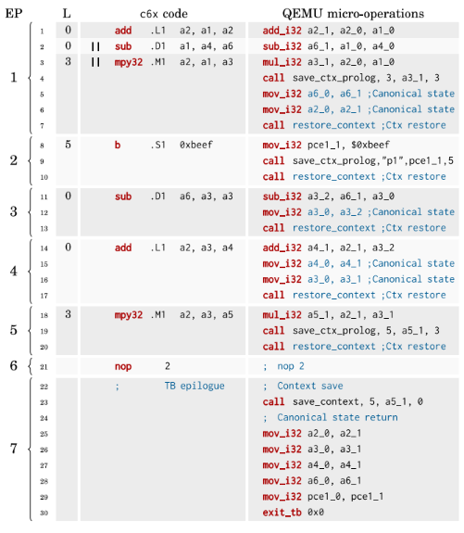
Difficulty of save_context
Context restore uses the dynamic waiting queue state to know which modifications to apply at the current cycle.
It must be interleaved with execution of each EP.
During context save, the biggest delay that can introduced is p − 1, so we will need at most p cycles
At the end of each EP, do canonical state.

Slide 15
Branch instructions special case
If a branch is waiting in the dynamic waiting queue at the start of a TB,the next TB will have to end a few cycles.
The result of previous instructions may lose if a branch restores.
Use a function save_ctx_prolog to solve this problem

Slide 16
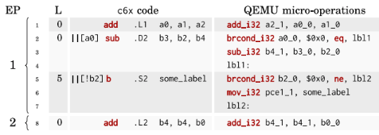
Predicated Instructions Handling
Predicated instruction with zero latency
copy back the value of the old replicate into the new one if the condition is false.
Predicated instruction with nonzero latency
condition flags
Complemented conditions with same destination
Predicated branch instructions

Slide 17
Outline
Introduction
VLIW architecture simulation with DBT
Experimentation
Conclusion

Slide 18
Experimentation
test program
Fibonacci number -> O(2^n)
product of two square matrices -> O(n^3)
inverse discrete cosine transform -> O(n)
Environment
GCC 4.9.1
8 Intel Xeon E5-2665 processors clocked at 2.40 GHz
256 GB memory.

Slide 19
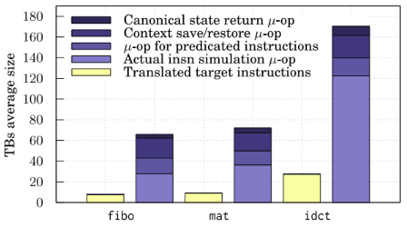
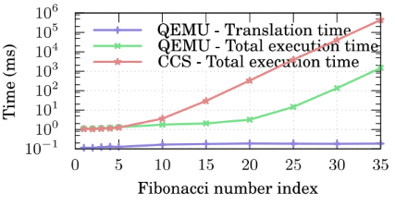
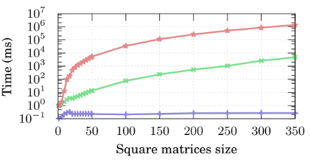
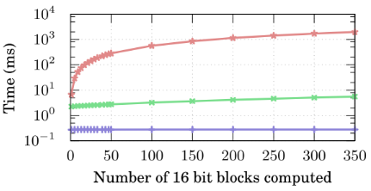

Slide 20
Outline
Introduction
VLIW architecture simulation with DBT
Experimentation
Conclusion

Slide 21
Conclusion
It presents a solution to handle VLIW peculiarities when translating binary codes dynamically on scalar architectures.
It does not perform any optimization on the generated code, but achieve high simulation speed.

